Slide 1
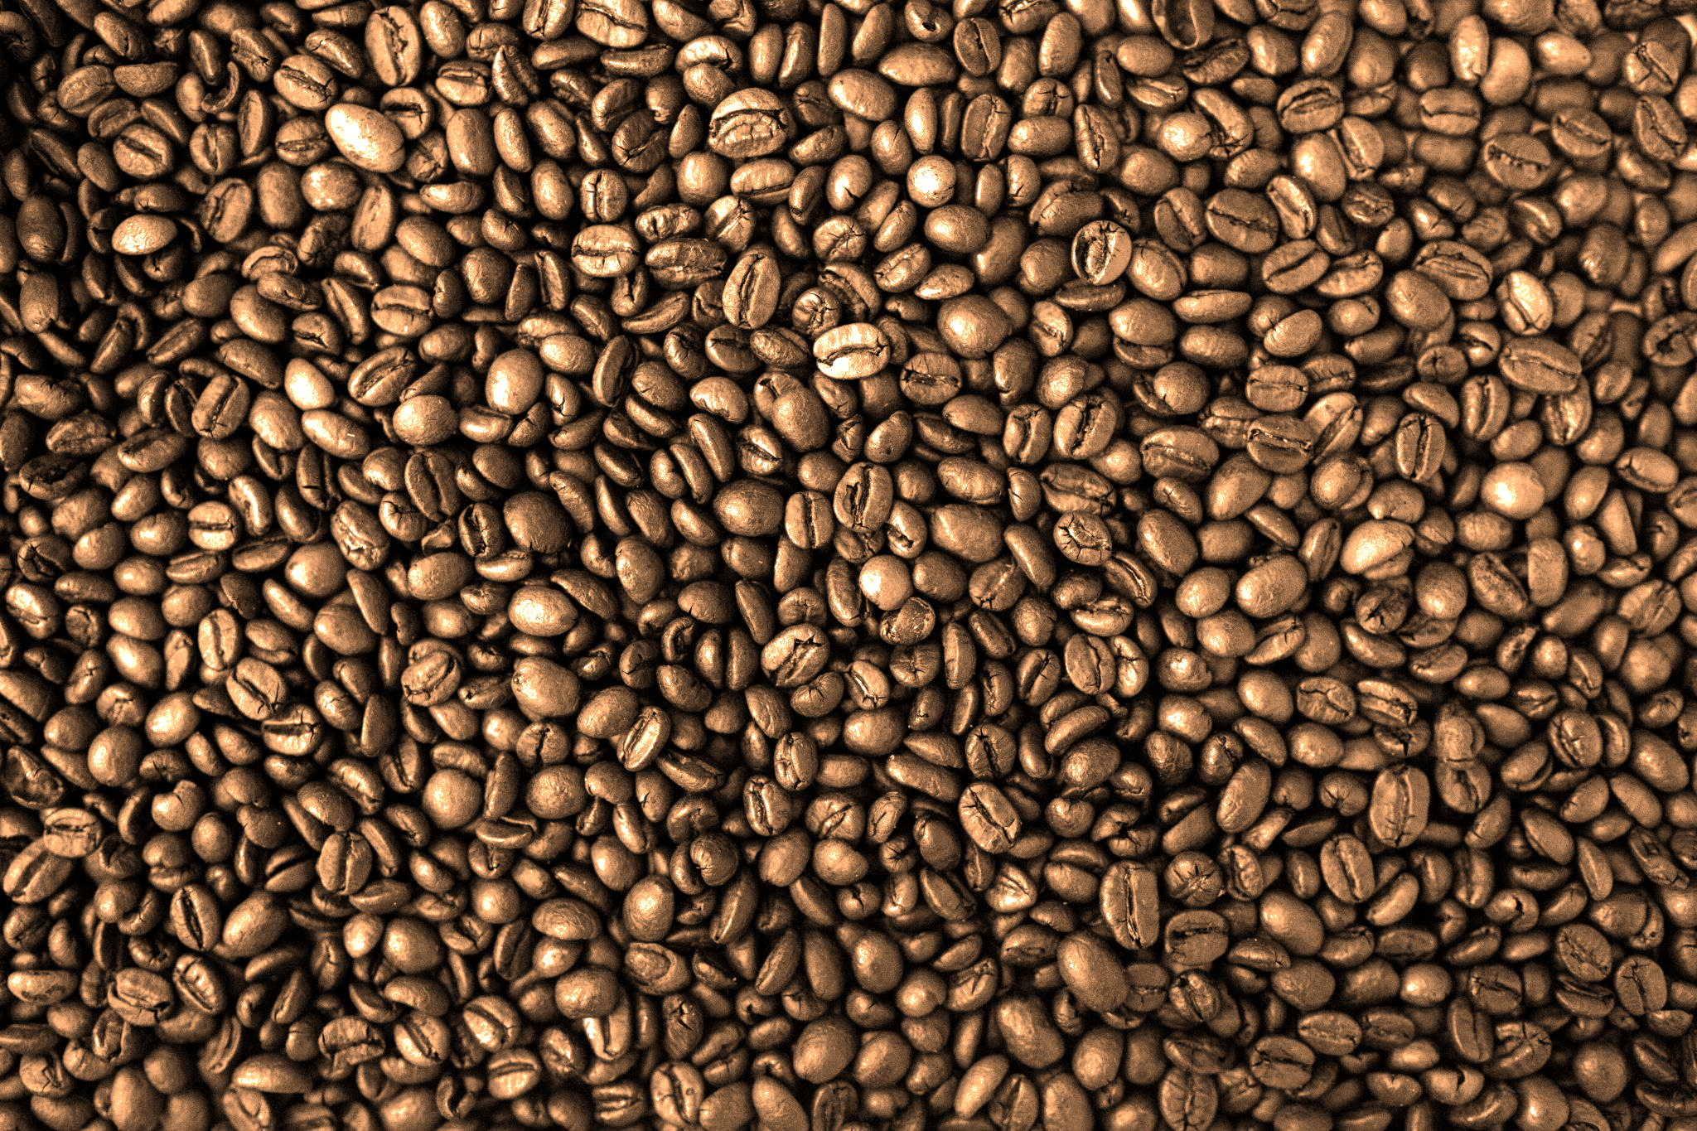
PREDICTIVE ANALYSIS OF COFFEE CONSUMPTION
C Keilers, L Nyazika, A Srinivasan

Slide 2
Agenda
Introduction
Problem Statement
Data Exploration
Methodology
Pre-processing
Mining
Model Performance
LoP
Conclusion

Slide 3
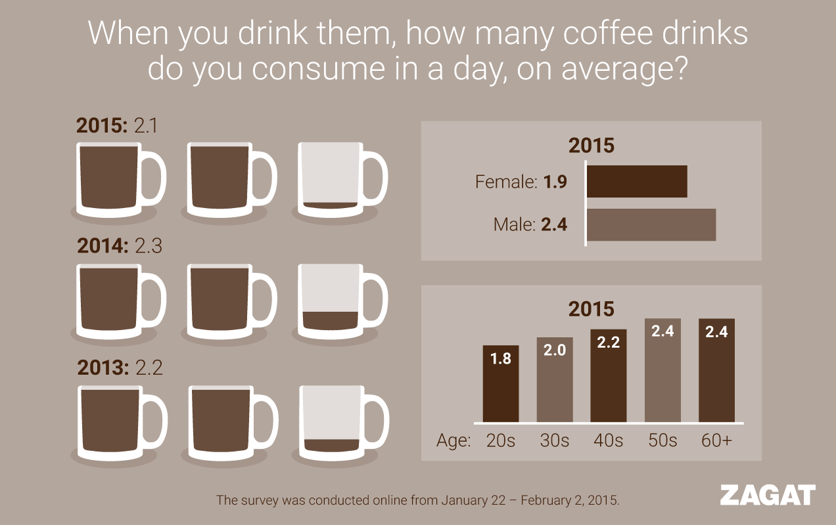
Introduction
Caffeine the main active ingredient in coffee is a stimulant drug.
Caffeine is a drug that is harmless in small doses, but can create drug dependency and is toxic in large enough doses.
The coffee market is growing and there is increased coffee imports in the United States (US).

Slide 4
Project Statement:
Our study is multivariate analysis of possible influences, key players contributing to the surge in coffee consumption, and subsequently driving the surge in imports of coffee.
Population growth
Increasing technology,
Company infrastructure, or
Generational shifts.
Notes:
Technology at our fingertips arises a need for mental alertness or wakefulness.

Slide 5
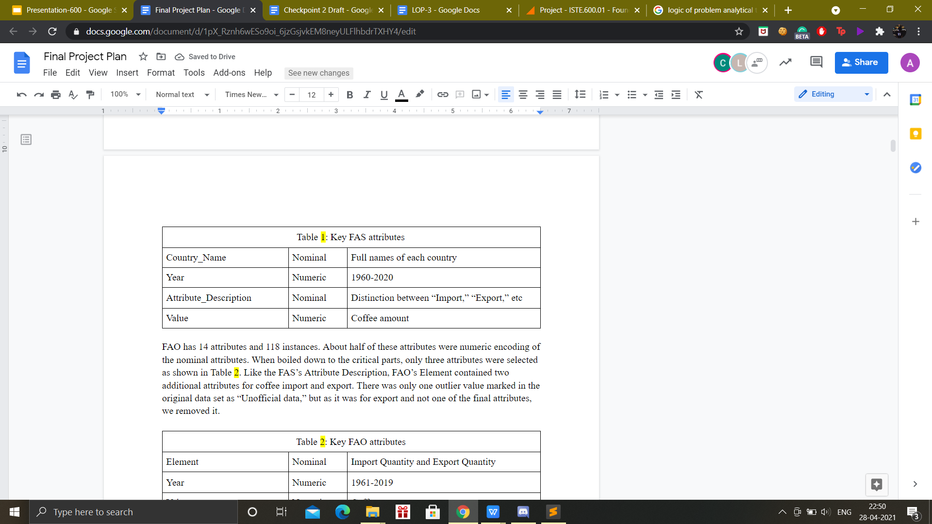
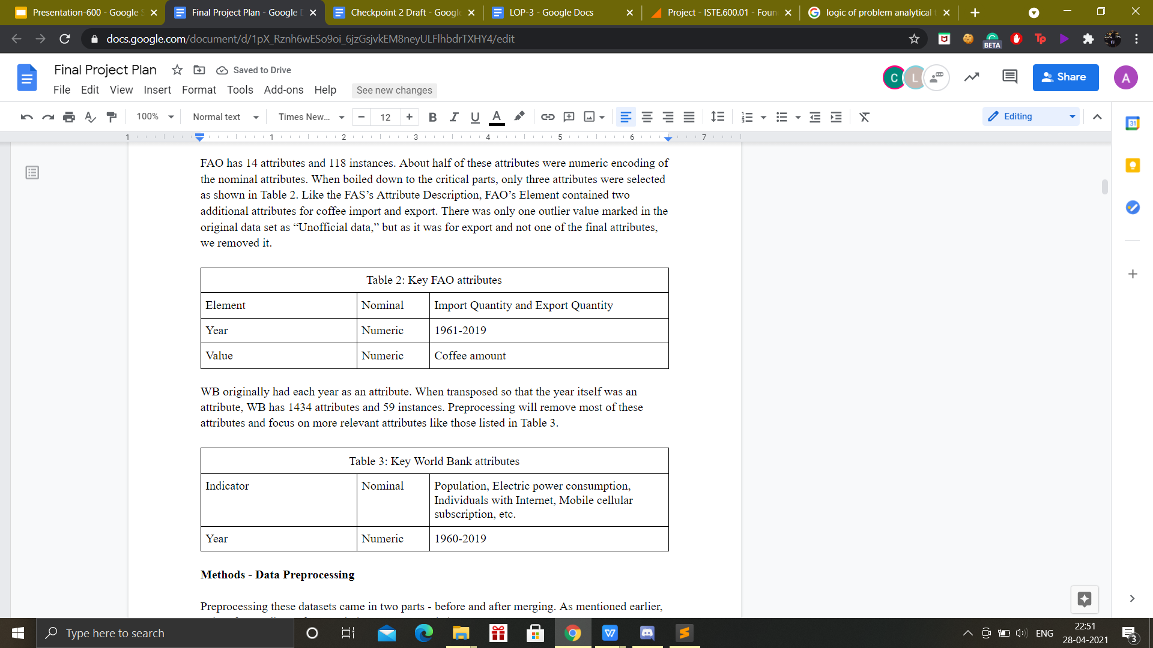
Data Exploration
Foreign Agricultural Service (FAS)
74309 instances
12 attributes
Food and Agriculture Organization of the United Nations (FAO)
118 instances
14 attributes
World Bank
59 instances
1434 attributes

Slide 6
Methodology

Slide 7
Data Preprocessing
Food & Agriculture Organization (FAO)
World Bank
Foreign Agricultural Service (FAS)
Filtered Attribute Description for Domestic Consumption, Total Supply, and Imports.
Outliers from domestic consumption and imports are either replaced or removed.
Attributes like Month and Description were redundant
Removed duplicate and extraneous attributes which included the Country Name and Item both of which only had one value.
FAO did not have years 1960, 2020, and 2021 like FAS. 1960 was replaced with 0, 2020 and 2021 were temporarily filled with means, but replaced with time series delta.
Removed extraneous attributes like Country Names and Indicator Code.
Selected Electric power consumption, Individuals using the Internet, Mobile cellular subscriptions, and Population attributes.

Slide 8
Data Mining
Linear Regression
Attribute selection parameter
M5 method
Greedy method
No attribute selection
Additive Regression with Simple Regression
Shrinkage parameters
1.0
0.8
0.5
Created 10 models
Testing Options
10-fold cross validation
Percentage Split

Slide 9
Linear Regression Models
 | Models with lowest RAE | Parameters
Import (FAS) | 0 * Electric power consumption + 0.0208 * Fixed broadband subscriptions + 0.0001 * Individuals using the Internet + -0.0045 * Mobile cellular subscriptions + -0.0128 * Urban population | M5 Method
Import (FAO) | -0 * Electric power consumption + -0.0064 * Fixed broadband subscriptions + -0.0055 * Fixed telephone subscriptions + 0 * Individuals using the Internet + 0.0057 * Population total + -0.0284 * Rural population + 0.0062 * Urban population | No Attribute Selection
Domestic Consumption | 0.0226 * Fixed broadband subscriptions + 0.0001 * Individuals using the Internet + -0.0067 * Mobile cellular subscriptions | Greedy Method
Total Supply | 0 * Electric power consumption + 0.0254 * Fixed broadband subscriptions + 0.0001 * Individuals using the Internet + -0.0055 * Mobile cellular subscriptions + -0.0162 * Urban population | Greedy Method

Slide 10
Additive Regression Models
 | Model 1 | Model 2 | Parameters
Import (FAS) | 0.02 * Fixed broadband subscriptions - 373100.16 | 0 * Individuals using the Internet - 237182.46 | Shrinkage = 0.5
Import (FAO) | 0 * Fixed broadband subscriptions - 69714.85 | -0.02 * Rural population + 1150926.12 | Shrinkage = 0.8
Domestic Consumption | 0.01 * Fixed broadband subscriptions - 363749.15 | 0 * Individuals using the Internet - 101433.12 | Shrinkage = 0.8
Total Supply | 0.02 * Fixed broadband subscriptions - 459020.04 | 0 * Individuals using the Internet - 132563.95 | Shrinkage = 0.8

Slide 11
Model Performance
Correlation coefficient
Relative Absolute Error (RAE)

Slide 12
Linear Regression Evaluation
 |  | Import (FAS) |  | Import (FAO) |  | Consumption |  | Total Supply
Parameters | Test | Corr Co | RAE (%) | Corr Co | RAE (%) | Corr Co | RAE (%) | Corr Co | RAE (%)
Default (M5 method) | 10-fold | 0.97 | 15.19 | 0.43 | 72.12 | 0.97 | 16.82 | 0.97 | 16.17
 | 66% Split | 0.96 | 19.67 | 0.21 | 81.06 | 0.95 | 19.75 | 0.96 | 19.45
 | 80% Split | 0.99 | 7.82 | 0.64 | 78.07 | 0.99 | 9.98 | 0.99 | 10.28
Greedy Method | 10-fold | 0.97 | 14.04 | 0.41 | 75.64 | 0.97 | 15.60 | 0.97 | 15.78
 | 66% Split | 0.96 | 15.24 | 0.21 | 81.06 | 0.95 | 19.75 | 0.96 | 19.45
 | 80% Split | 0.99 | 7.82 | 0.48 | 88.44 | 0.99 | 7.79 | 1.00 | 7.51
No attribute selection | 10-fold | 0.97 | 16.06 | 0.42 | 77.00 | 0.97 | 16.85 | 0.97 | 17.05
 | 66% Split | 0.96 | 19.68 | 0.21 | 82.34 | 0.95 | 21.33 | 0.96 | 20.96
 | 80% Split | 0.99 | 12.18 | 0.68 | 68.75 | 0.99 | 11.97 | 1.00 | 12.89

Slide 13
Additive Regression Evaluation
 |  | Import (FAS) |  | Import (FAO) |  | Consumption |  | Total Supply
Parameters | Test | Corr Co | RAE (%) | Corr Co | RAE (%) | Corr Co | RAE (%) | Corr Co | RAE (%)
Shrinkage = 1.0 | 10-fold | 0.96 | 15.70 | 0.43 | 69.60 | 0.96 | 16.50 | 0.96 | 16.69
 | 66% Split | 0.95 | 14.74 | 0.21 | 77.80 | 0.94 | 17.01 | 0.94 | 16.04
 | 80% Split | 0.99 | 9.20 | 0.58 | 87.74 | 0.98 | 9.69 | 0.98 | 10.41
Shrinkage = 0.8 | 10-fold | 0.96 | 14.99 | 0.43 | 69.52 | 0.96 | 15.37 | 0.96 | 15.76
 | 80% Split | 0.99 | 8.32 | 0.59 | 86.80 | 0.98 | 9.00 | 0.98 | 9.12
Shrinkage = 0.5 | 10-fold | 0.96 | 15.09 | 0.43 | 69.94 | 0.96 | 15.37 | 0.96 | 15.37
 | 80% Split | 0.99 | 9.23 | 0.57 | 88.93 | 0.98 | 9.06 | 0.99 | 9.74

Slide 14
Logic Of Problem (LoP)
LoP is an analytical tool that provides us with in-depth analysis of the topic we are studying/researching.
The LoP was updated with every checkpoint as we continued with our research. Initially, we had a pretty board idea and kept narrowing it down depending on the results of each checkpoint.
By the end of checkpoint 4 we had reached a consensus about our initial assumption that coffee consumption can be linked to increase in population and advancement in technology.

Slide 15

Conclusion
Attributes changes the data.
Caffeinated coffee is choice fuel for alertness and productivity in this fast paced technological world.
Trajectory shows this trend to be continuous.
A vast majority of the population love coffee.

Slide 16
References
Foreign Agricultural Service, “Coffee,” United States Department of Agriculture, Dec. 11, 2020. [Online Dataset]. Available: https://apps.fas.usda.gov/psdonline/app/index.html#/app/downloads.
Food and Agriculture Organization of the United Nations, “Data,” Food and Agriculture Organization of the United Nations, 2021. Available: http://www.fao.org/faostat/en/#data.
The World Bank, “United States,” World Bank Group, Feb. 17, 2021. [Online Dataset]. Available: https://data.worldbank.org/country/united-states?view=chart.

Slide 17
Picture Citation In Order of Appearance
Negative Space. https://www.pexels.com/photo/brown-cocoa-34085/.
Coffee Trends. https://zagat.googleblog.com/2015/02/national-coffee-trends-revealed.html
Chevanon Photography. https://www.pexels.com/photo/close-up-of-coffee-cup-on-table-312418/.

